Slide 1
Interfacing of Stepper Motor with 8051
Melvin C Jose

Slide 2
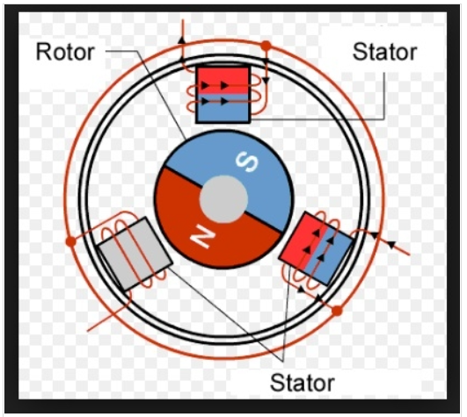
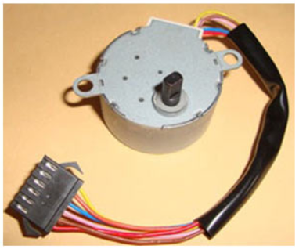
Stepper Motor
Stepper motors are used to translate electrical pulses into mechanical movements.
The main advantage of using the stepper motor is the position control.
Stepper motors generally have a permanent magnet shaft (rotor), and it is surrounded by a stator.

Slide 3
Stepper Motor
Normal motor shafts can move freely but the stepper motor shafts move in fixed repeatable increments.
Some parameters of stepper motors
Step Angle − The step angle is the angle in which the rotor moves when one pulse is applied as an input of the stator. This parameter is used to determine the positioning of a stepper motor.
Steps per Revolution − This is the number of step angles required for a complete revolution. So the formula is 360° /Step Angle.
Steps per Second − This parameter is used to measure a number of steps covered in each second.
RPM − The RPM is the Revolution Per Minute. It measures the frequency of rotation. By this parameter, we can measure the number of rotations in one minute.

Slide 4
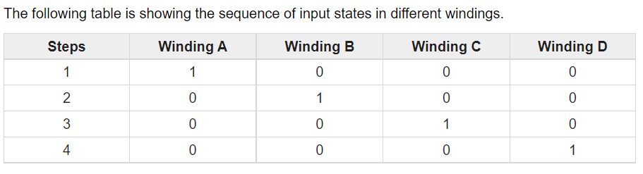
Stepper Motor
The Unipolar stepper motor works in three modes.
Wave Drive Mode − In this mode, one coil is energized at a time. So all four coils are energized one after another. This mode produces less torque than full step drive mode.

Slide 5
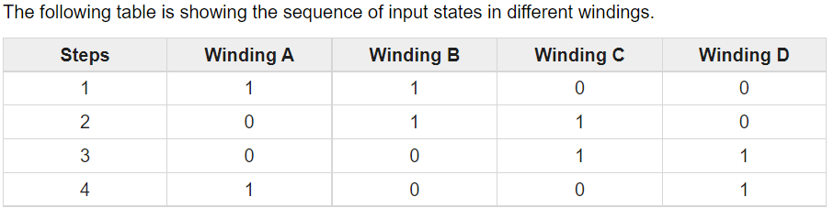
Stepper Motor
Full Drive Mode − In this mode, two coils are energized at the same time. This mode produces more torque. Here the power consumption is also high

Slide 6
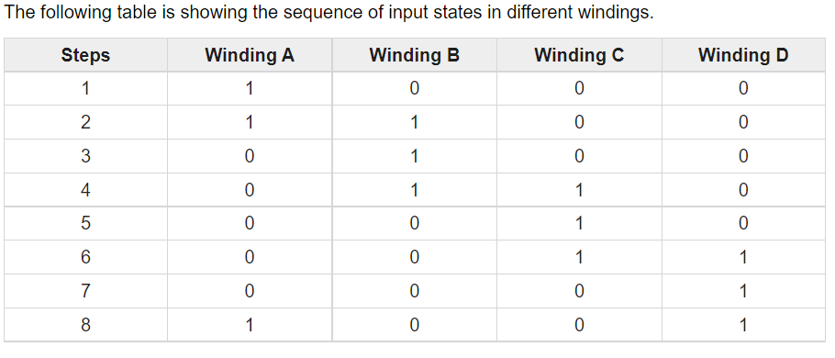
Stepper Motor
Half Drive Mode − In this mode, one and two coils are energized alternately. At first, one coil is energized then two coils are energized. This is basically a combination of wave and full drive mode. It increases the angular rotation of the motor

Slide 7
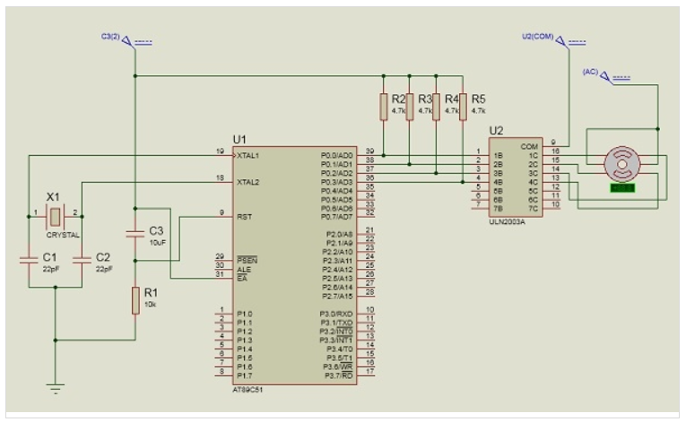
Stepper Motor –Full Drive Mode
Here using Port P0 of 8051 for connecting the stepper motor.
HereULN2003 is used. This is basically a high voltage, high current Darlington transistor array.
Each ULN2003 has seven NPN Darlington pairs.
It can provide high voltage output with common cathode clamp diodes for switching inductive loads.

Slide 8
Stepper Motor –Full Drive Mode
Full drive Mode
#include<reg51.h>
void msdelay(unsigned int time)
{
unsigned i,j ;
for(i=0;i<time;i++)
for(j=0;j<1275;j++);
}
void main()
{
while(1)
{
P0 = 0x03; //0011 P0_0=1,P0_1=1,P0_2=0,P0_3=0
msdelay(1);
P0 = 0x06; //0110
msdelay(1);
P0 = 0x0C; //1100
msdelay(1);
P0 = 0x09; //1001
msdelay(1);
}
}

